Slide 1

Presentation of the
42nd Bi-annual Report
Jakob Sjövall
Permanent Member of the COSAC Secretariat

Slide 2
42nd Bi-annual Report – Chapter One
Eleven Parliaments/Chambers are involved in the nomination of candidates to the General Court & Court of Justice; ten in nominating Commissioners; and nine in nominating members of the Court of Auditors
In 26 national Parliaments/Chambers, MEPs may take part in meetings
In 27 Parliaments/Chambers, the government position is discussed ahead of European Council meetings
Twenty national Parliaments/Chambers report using the subsidiarity check mechanism as set out in Protocol 2 of the Lisbon Treaty

Slide 3
42nd Bi-annual Report – Chapter Two
Ten Parliaments/Chambers have discussed the Commission toolbox on demographic change (COM(2023) 557) in the EU affairs committee; seven have done so in other committees
In 16 Parliaments/Chambers there is a committee responsible for demographic issues
Many Parliaments/Chambers gave detailed responses on measures taken at national level to deal with demographic trends

Slide 4
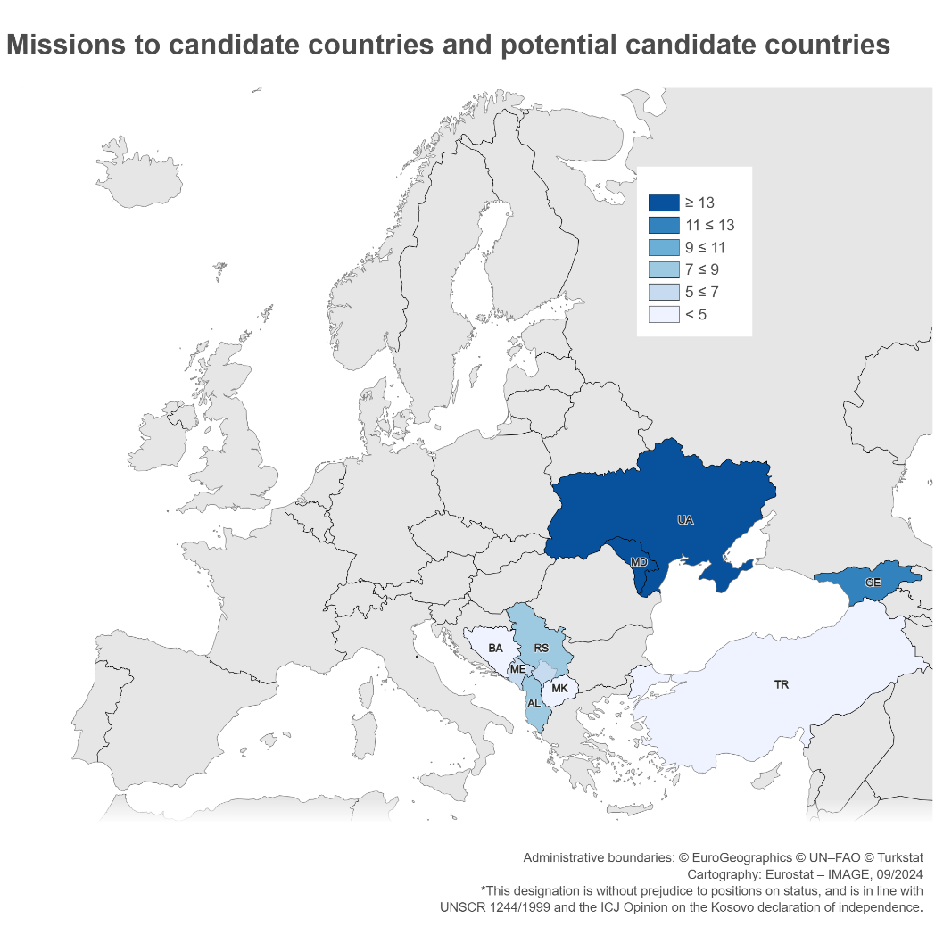
42nd Bi-annual Report – Chapter Three
The Commission annual enlargement package 2023 has been discussed in 28 Parliaments/Chambers
Cooperation with candidate or potential candidate countries parliaments exists in 34 Parliaments/Chambers
Since January 2023, 16 missions to UA, 14 to MD, 12 to GE.

